Slide 1
Fast Fourier Transform
CS121 Parallel Computing
Spring 2018

Slide 2
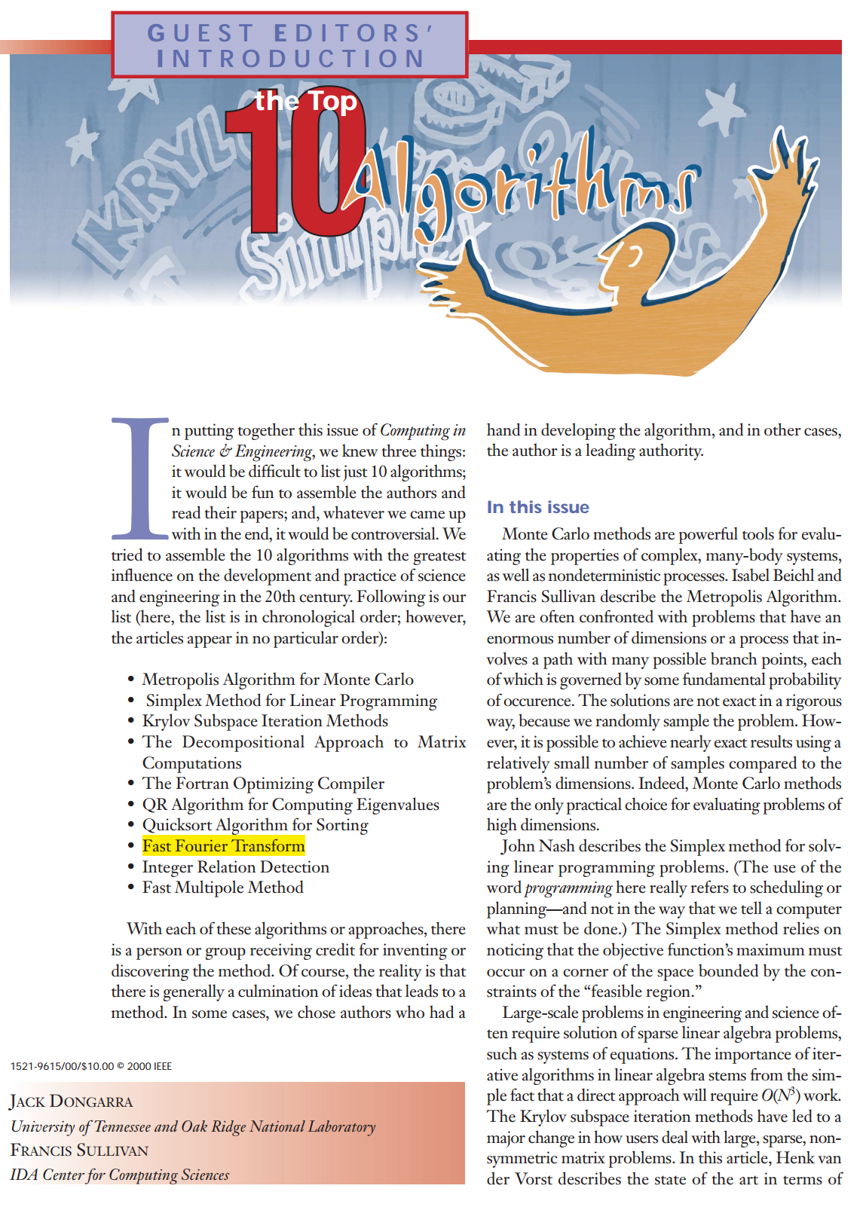
Fourier transform
Translate an input from the space to time domain.
FFT used for signal processing, operations on polynomials and matrices, convolutions and filtering, differential equations, machine learning, etc.
One of IEEE’s top 10 most important algorithms of the 20th century.
Popularized by Cooley and Tukey in 1965.
But variants known to Gauss in 1805!

Slide 3
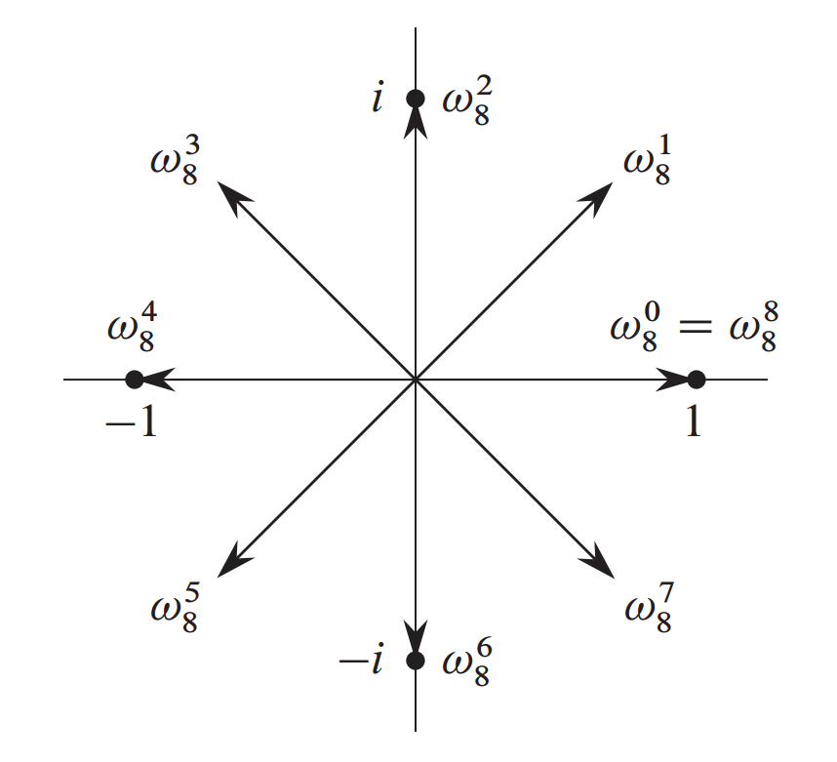
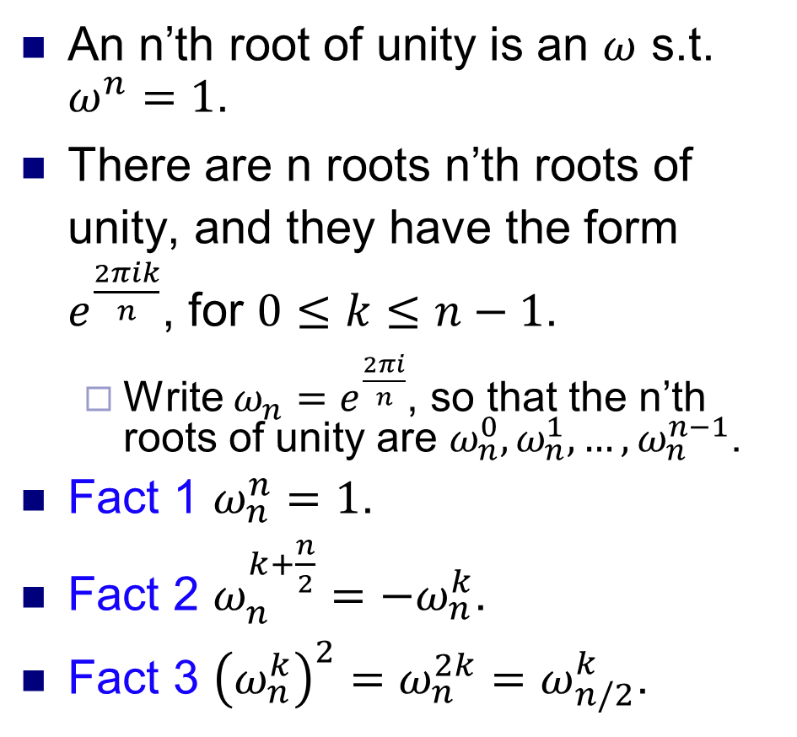
Roots of unity
An n’th root of unity is an $ω$ s.t. $ω^{n}=1$.
There are n roots n’th roots of unity, and they have the form $e^{\frac{2πik}{n}}$, for $0≤k≤n−1$.
Write $ω_{n}=e^{\frac{2πi}{n}}$, so that the n’th roots of unity are $ω_{n}^{0}, ω_{n}^{1}, …, ω_{n}^{n−1}$.
Fact 1 $ω_{n}^{n}=1$.
Fact 2 $ω_{n}^{k+\frac{n}{2}}=−ω_{n}^{k}$.
Fact 3 ${\left(ω_{n}^{k}\right)}^{2}=ω_{n}^{2k}=ω_{n/2}^{k}$.
Source: Introduction to Algorithms, Cormen et al.

Slide 4
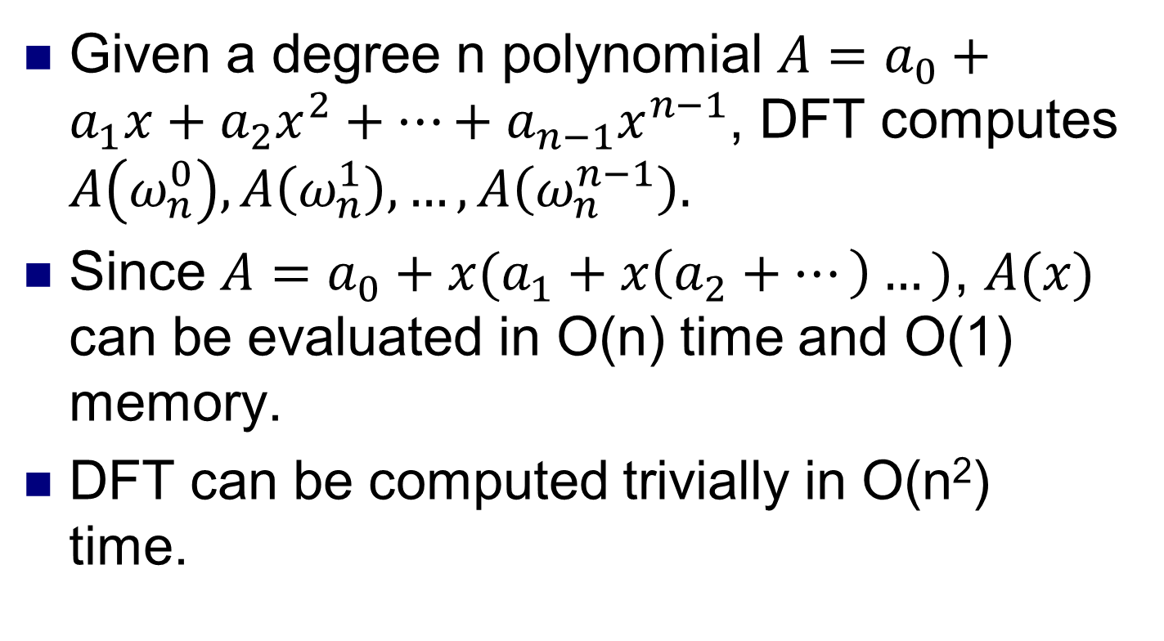
Discrete Fourier Transform
Given a degree n polynomial $A=a_{0}+a_{1}x+a_{2}x^{2}+…+a_{n−1}x^{n−1}$, DFT computes $A\left(ω_{n}^{0}\right), A\left(ω_{n}^{1}\right), …, A\left(ω_{n}^{n−1}\right).$
Since $A=a_{0}+x(a_{1}+x\left(a_{2}+…\right)…)$, $A(x)$ can be evaluated in O(n) time and O(1) memory.
DFT can be computed trivially in O(n²) time.

Slide 5
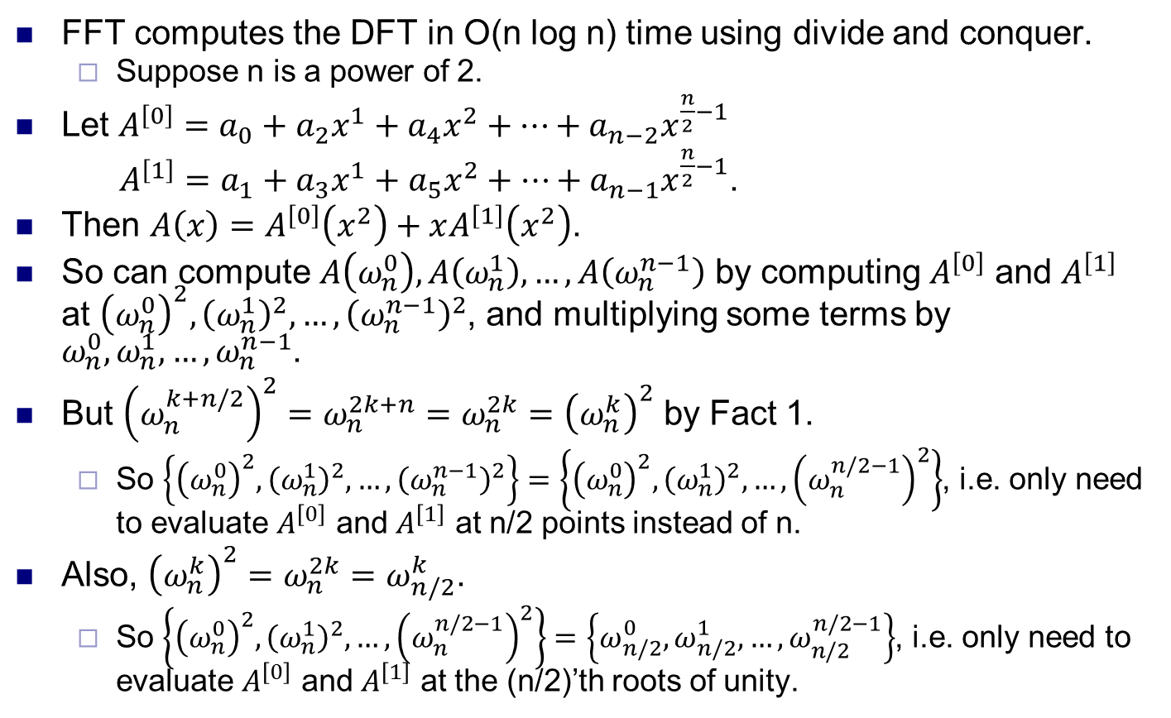
Fast Fourier Transform
FFT computes the DFT in O(n log n) time using divide and conquer.
Suppose n is a power of 2.
Let $A^{\left[0\right]}=a_{0}+a_{2}x^{1}+a_{4}x^{2}+…+a_{n−2}x^{\frac{n}{2}−1}$
$A^{\left[1\right]}=a_{1}+a_{3}x^{1}+a_{5}x^{2}+…+a_{n−1}x^{\frac{n}{2}−1}$.
Then $A\left(x\right)=A^{\left[0\right]}\left(x^{2}\right)+xA^{\left[1\right]}\left(x^{2}\right)$.
So can compute $A\left(ω_{n}^{0}\right), A\left(ω_{n}^{1}\right), …, A\left(ω_{n}^{n−1}\right)$ by computing $A^{\left[0\right]}$ and $A^{\left[1\right]}$ at ${\left(ω_{n}^{0}\right)}^{2}, {\left(ω_{n}^{1}\right)}^{2}, …, {\left(ω_{n}^{n−1}\right)}^{2}$, and multiplying some terms by $ω_{n}^{0}, ω_{n}^{1}, …, ω_{n}^{n−1}$.
But ${\left(ω_{n}^{k+n/2}\right)}^{2}=ω_{n}^{2k+n}=ω_{n}^{2k}={\left(ω_{n}^{k}\right)}^{2}$ by Fact 1.
So $\left\{{\left(ω_{n}^{0}\right)}^{2}, {\left(ω_{n}^{1}\right)}^{2}, …, {\left(ω_{n}^{n−1}\right)}^{2}\right\}=\left\{{\left(ω_{n}^{0}\right)}^{2}, {\left(ω_{n}^{1}\right)}^{2}, …, {\left(ω_{n}^{n/2−1}\right)}^{2}\right\}$, i.e. only need to evaluate $A^{\left[0\right]}$ and $A^{\left[1\right]}$ at n/2 points instead of n.
Also, ${\left(ω_{n}^{k}\right)}^{2}=ω_{n}^{2k}=ω_{n/2}^{k}$.
So $\left\{{\left(ω_{n}^{0}\right)}^{2}, {\left(ω_{n}^{1}\right)}^{2}, …, {\left(ω_{n}^{n/2−1}\right)}^{2}\right\}=\left\{ω_{n/2}^{0}, ω_{n/2}^{1},…, ω_{n/2}^{n/2−1}\right\}$, i.e. only need to evaluate $A^{\left[0\right]}$ and $A^{\left[1\right]}$ at the (n/2)’th roots of unity.

Slide 6
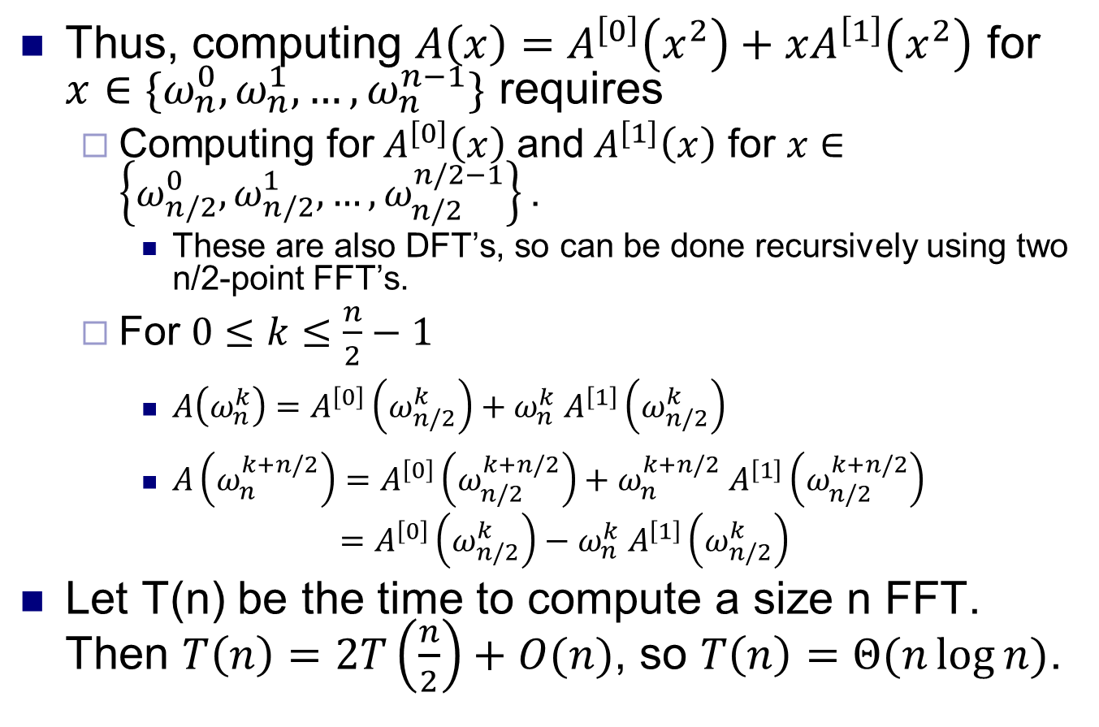
Fast Fourier Transform
Thus, computing $A\left(x\right)=A^{\left[0\right]}\left(x^{2}\right)+xA^{\left[1\right]}\left(x^{2}\right)$ for $x∈\{ω_{n}^{0}, ω_{n}^{1}, …, ω_{n}^{n−1}\text{\}}$ requires
Computing for${ A}^{\left[0\right]}\left(x\right)$ and${ A}^{\left[1\right]}\left(x\right)$ for $x∈\left\{ω_{n/2}^{0}, ω_{n/2}^{1},…, ω_{n/2}^{n/2−1}\right\}\text{.}$
These are also DFT’s, so can be done recursively using two n/2-point FFT’s.
For $0≤k≤\frac{n}{2}−1$
$A\left(ω_{n}^{k}\right)=A^{\left[0\right]}\left(ω_{n/2}^{k}\right)+ω_{n}^{k} A^{\left[1\right]}\left(ω_{n/2}^{k}\right)$
$A\left(ω_{n}^{k+n/2}\right)=A^{\left[0\right]}\left(ω_{n/2}^{k+n/2}\right)+ω_{n}^{k+n/2} A^{\left[1\right]}\left(ω_{n/2}^{k+n/2}\right)$
$$=A^{\left[0\right]}\left(ω_{n/2}^{k}\right)−ω_{n}^{k} A^{\left[1\right]}\left(ω_{n/2}^{k}\right)$$
Let T(n) be the time to compute a size n FFT. Then $T\left(n\right)=2T\left(\frac{n}{2}\right)+O(n)$, so $T\left(n\right)=Θ(n\log{n)}$.

Slide 7
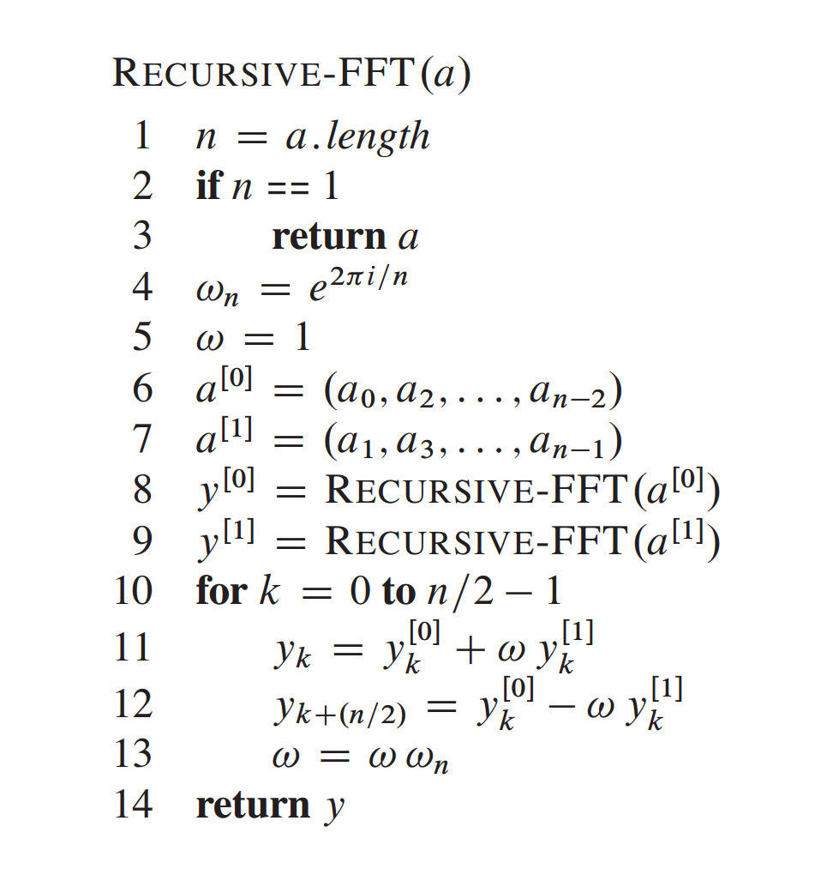
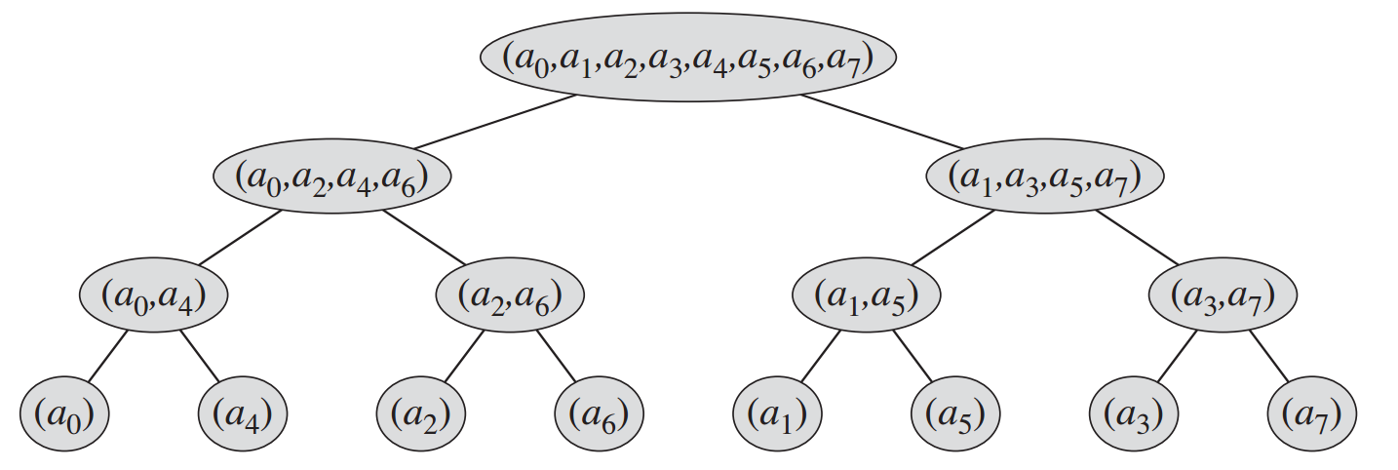
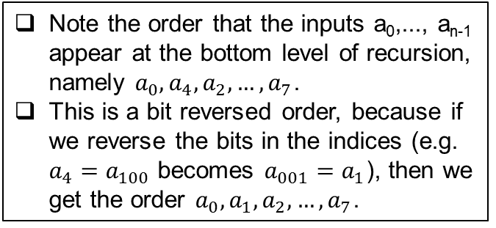
Recursive FFT
Note the order that the inputs a₀,..., a_{n-1} appear at the bottom level of recursion, namely $a_{0},a_{4},a_{2},…, a_{7}$.
This is a bit reversed order, because if we reverse the bits in the indices (e.g. $a_{4}=a_{100}$ becomes $a_{001}=a_{1}$), then we get the order $a_{0},a_{1},a_{2},…, a_{7}$.

Slide 8
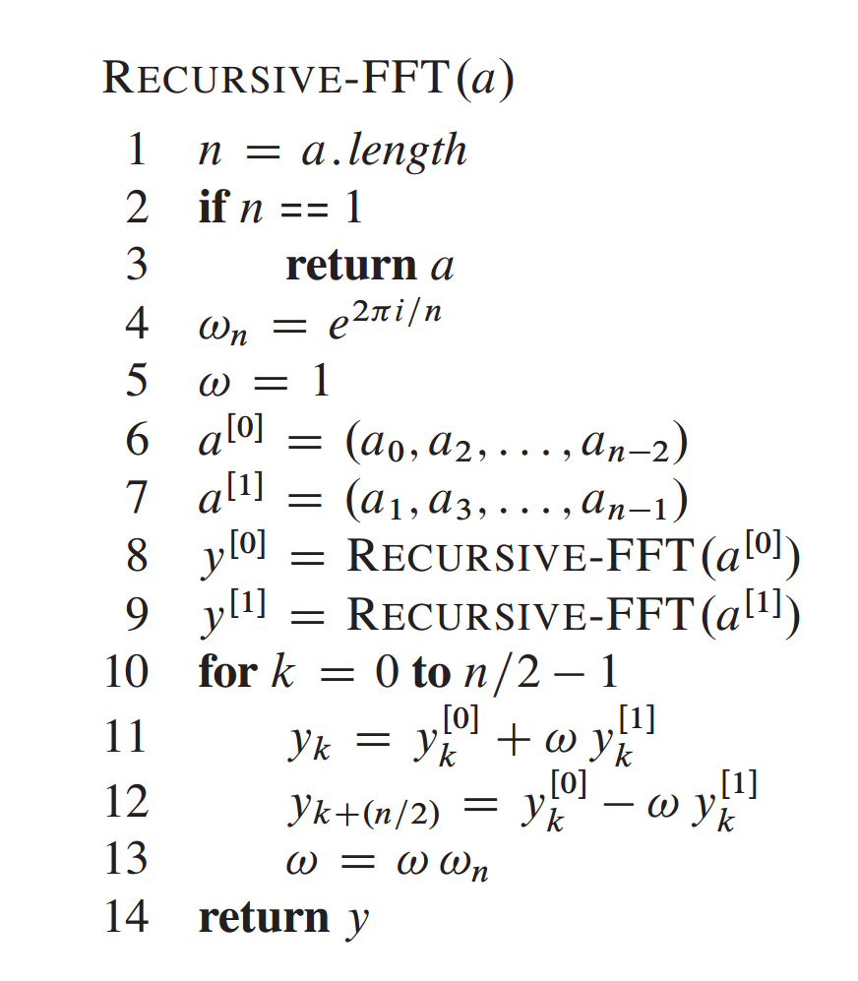
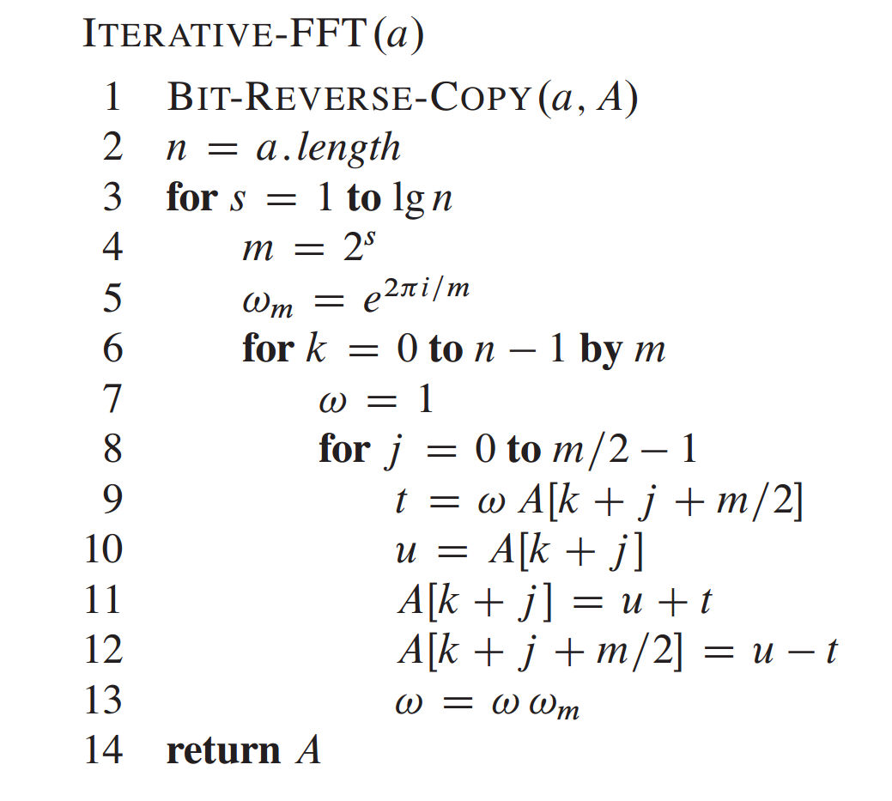
Iterative FFT

Slide 9
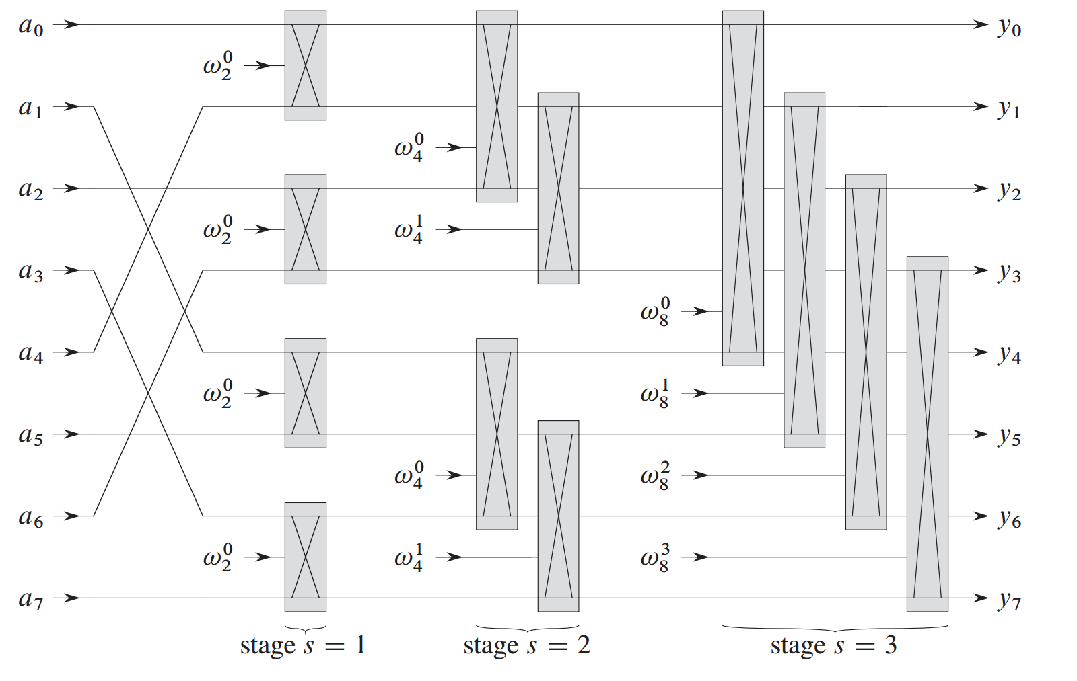
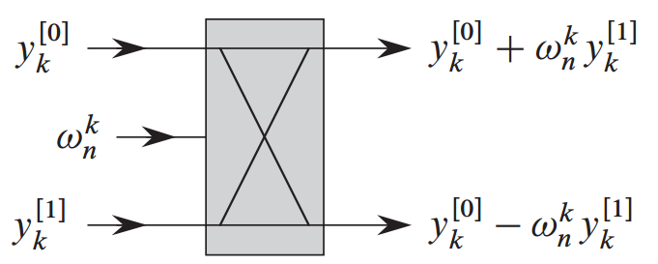
FFT circuit

Slide 10
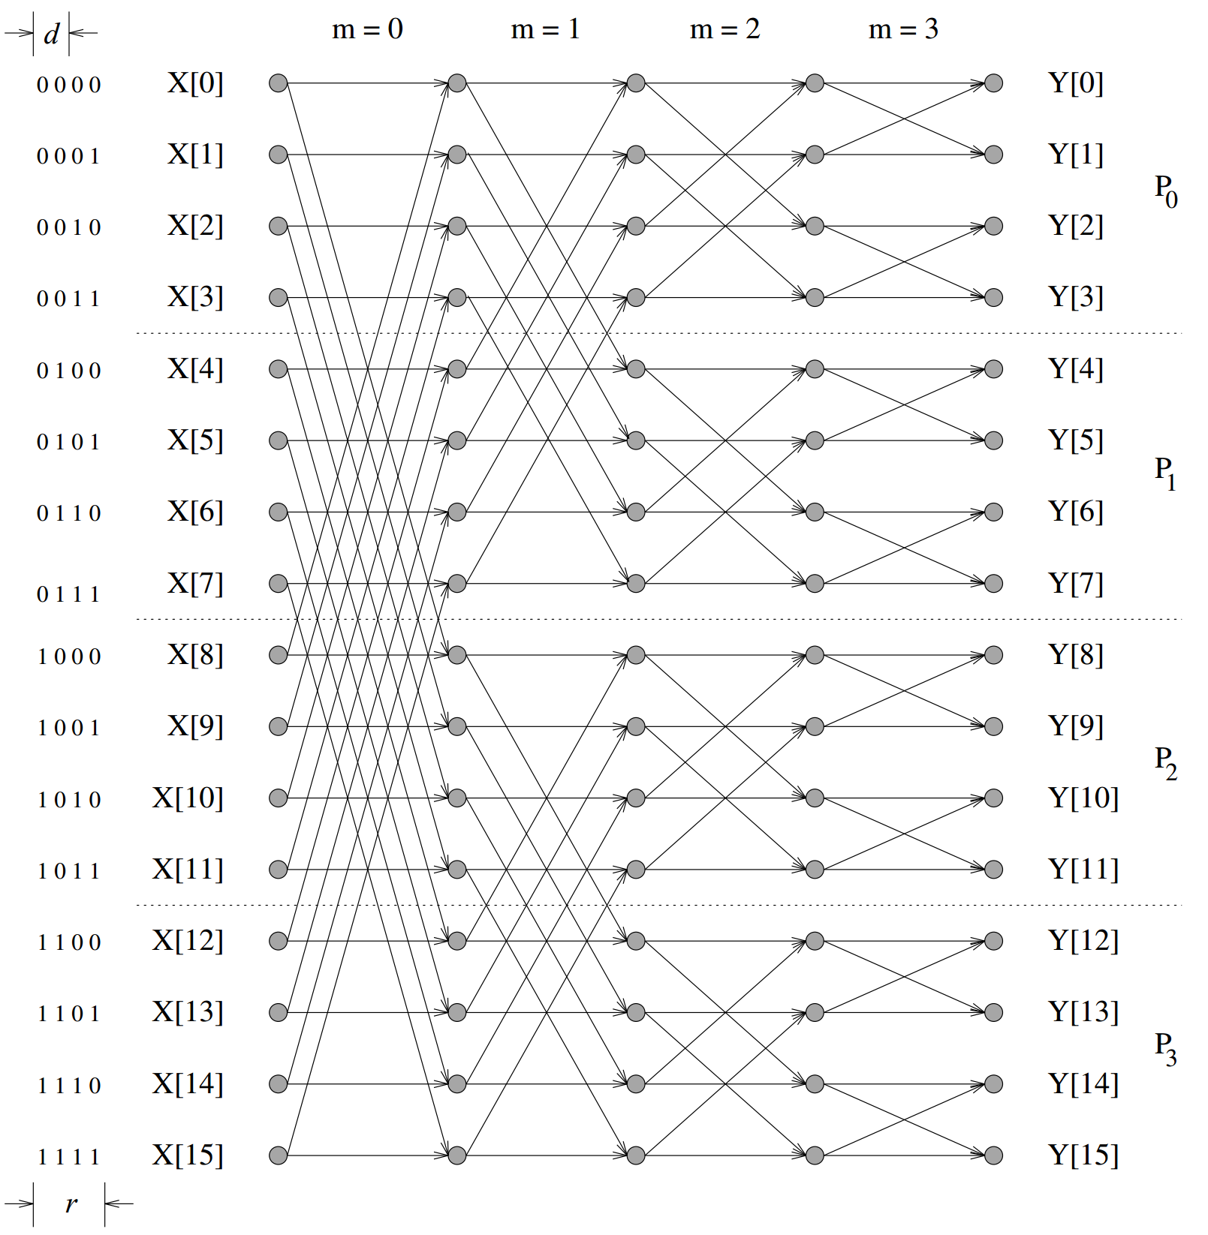
Binary exchange FFT
Consider doing n point FFT using p ≤ n processors.
Assume n, p are both powers of 2.
Let r = log n, d = log p.
Map n/p elements of input and output per processor.
In total r stages of computation.
In i’th stage, processors whose IDs differ in i’th digit communicate.
So communication during first d stages.
No communication in last r-d stages.

Slide 11
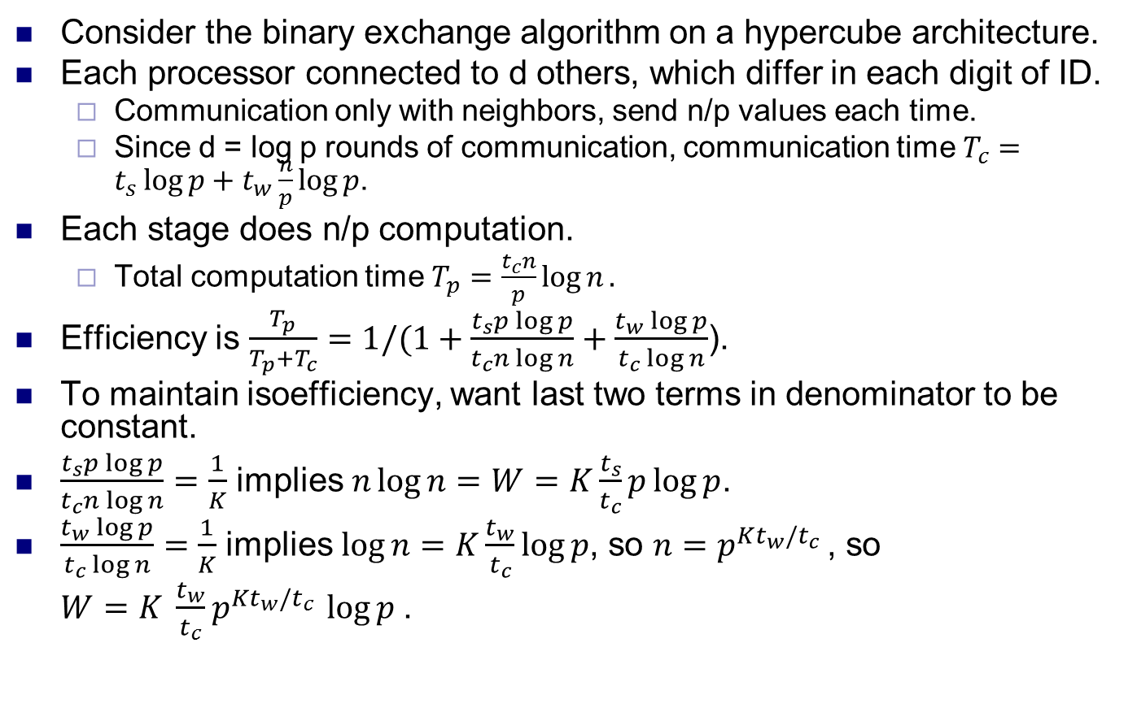
Efficiency on hypercube
Consider the binary exchange algorithm on a hypercube architecture.
Each processor connected to d others, which differ in each digit of ID.
Communication only with neighbors, send n/p values each time.
Since d = log p rounds of communication, communication time $T_{c}=t_{s}\log{p+t_{w}\frac{n}{p}\log{p}}$.
Each stage does n/p computation.
Total computation time $T_{p}=\frac{t_{c}n}{p}\log{n}.$
Efficiency is $\frac{T_{p}}{T_{p}+T_{c}}=1/(1+\frac{t_{s}p\log{p}}{t_{c}n\log{n}}+\frac{t_{w}\log{p}}{t_{c}\log{n}}$).
To maintain isoefficiency, want last two terms in denominator to be constant.
$\frac{t_{s}p\log{p}}{t_{c}n\log{n}}=\frac{1}{K}$ implies $n\log{n=W=K\frac{t_{s}}{t_{c}}p\log{p}}$.
$\frac{t_{w}\log{p}}{t_{c}\log{n}}=\frac{1}{K}$ implies $\log{n=K\frac{t_{w}}{t_{c}}\log{p}}$, so $n=p^{Kt_{w}/t_{c} }$, so
$W=K \frac{t_{w}}{t_{c}}p^{Kt_{w}/t_{c} }\log{p }$.

Slide 12
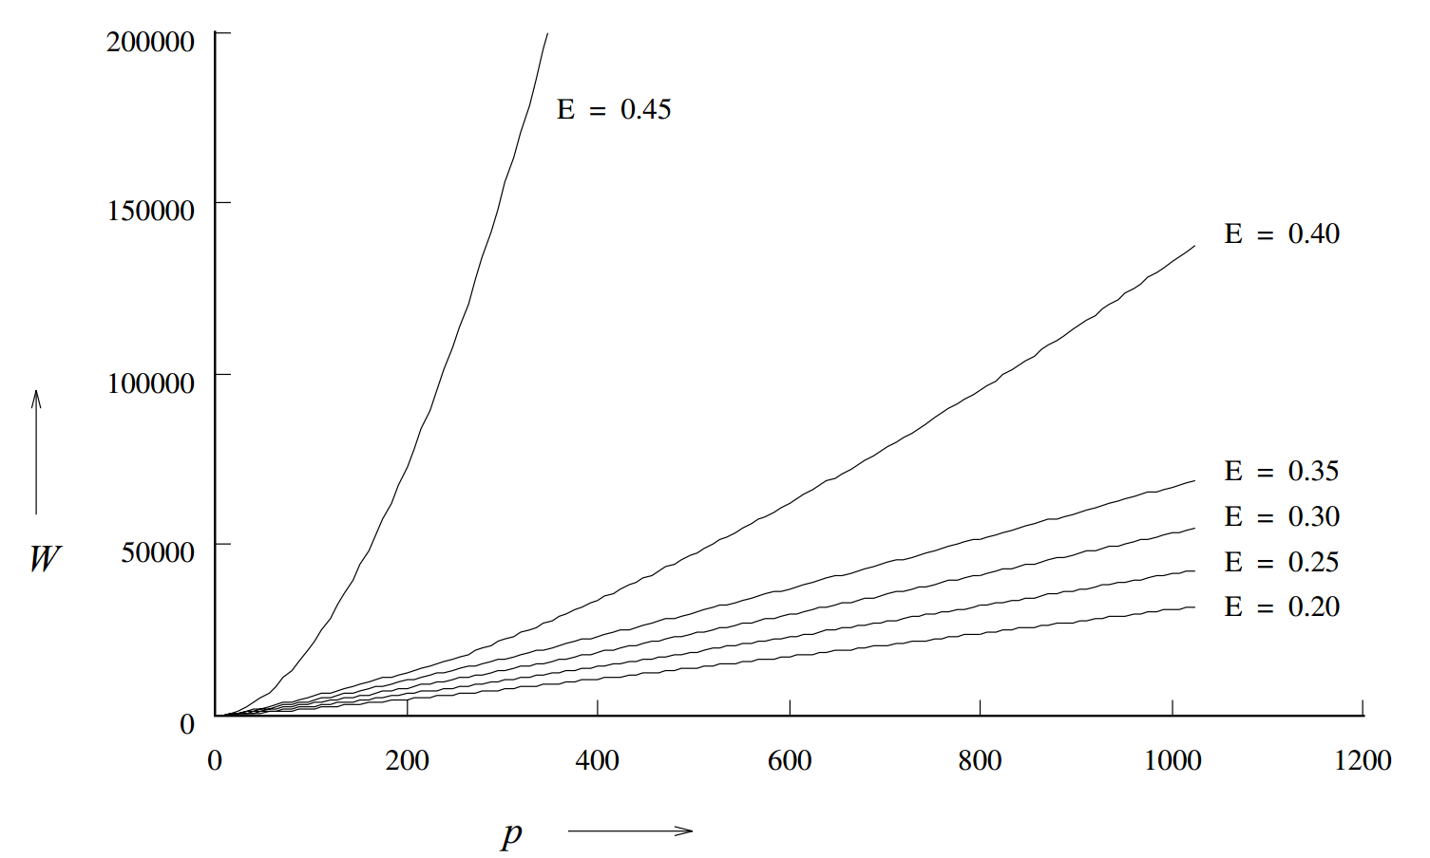
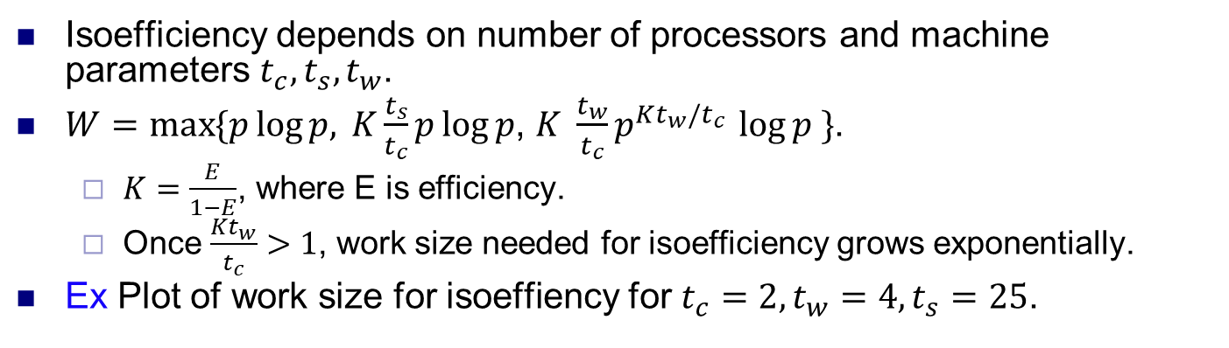
Efficiency
Isoefficiency depends on number of processors and machine parameters $t_{c}, t_{s}, t_{w}$.
$W=\max{\{p\log{p, }}K\frac{t_{s}}{t_{c}}p\log{p}$, $K \frac{t_{w}}{t_{c}}p^{Kt_{w}/t_{c} }\log{p \}}$.
$K=\frac{E}{1−E}$, where E is efficiency.
Once $\frac{Kt_{w}}{t_{c}}>1$, work size needed for isoefficiency grows exponentially.
Ex Plot of work size for isoeffiency for $t_{c}=2, t_{w}=4,t_{s}=25$.

Slide 13
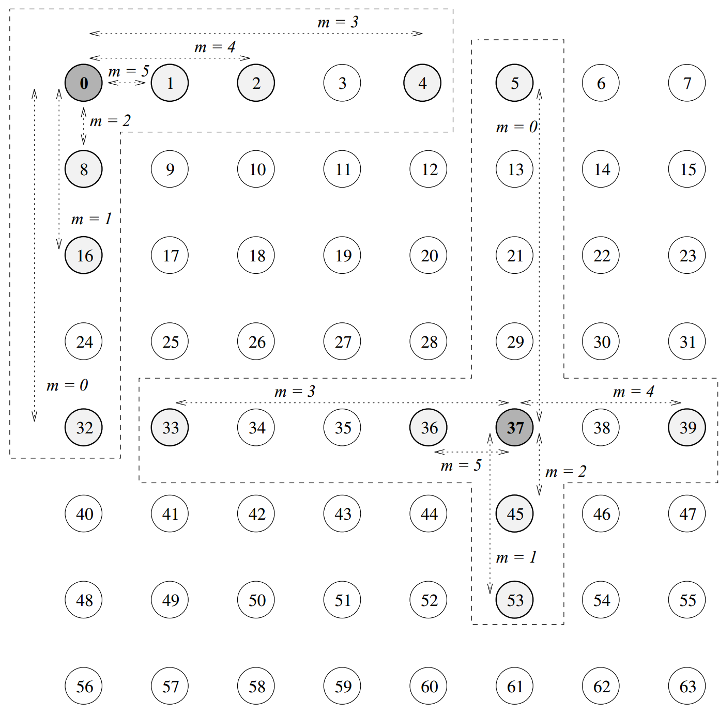
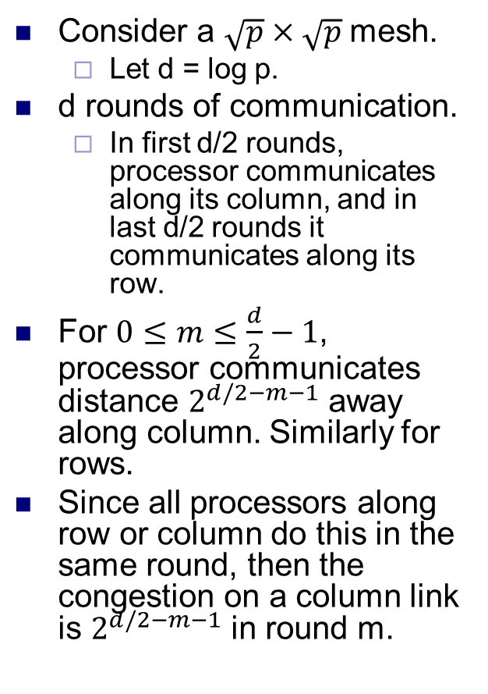
Binary exchange FFT on mesh
Consider a $\sqrt{p}×\sqrt{p}$ mesh.
Let d = log p.
d rounds of communication.
In first d/2 rounds, processor communicates along its column, and in last d/2 rounds it communicates along its row.
For $0≤m≤\frac{d}{2}−1$, processor communicates distance $2^{d/2−m−1}$ away along column. Similarly for rows.
Since all processors along row or column do this in the same round, then the congestion on a column link is $2^{d/2−m−1}$ in round m.

Slide 14
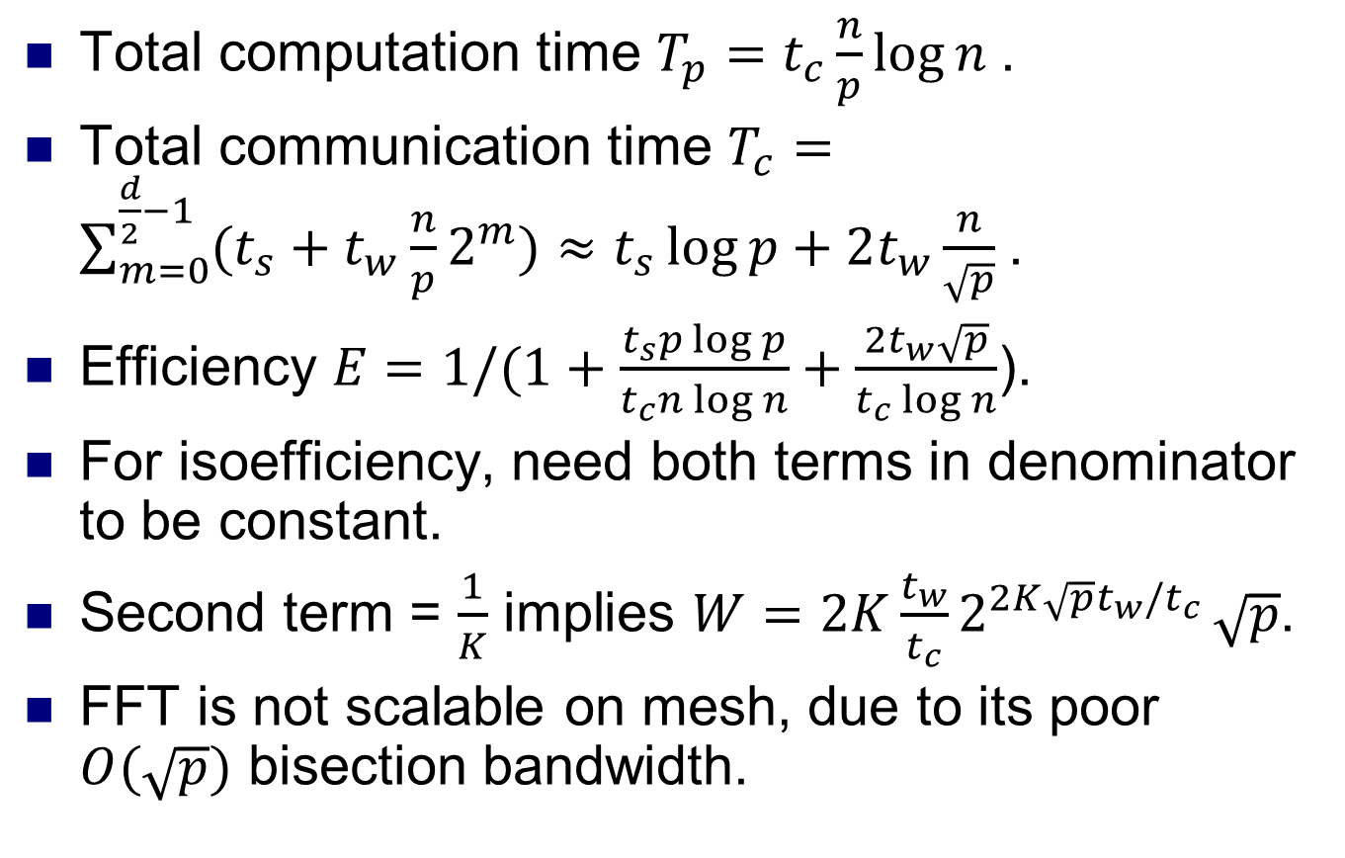
Efficiency on mesh
Total computation time $T_{p}=t_{c}\frac{n}{p}\log{n }$.
Total communication time $T_{c}=\sum_{m=0}^{\frac{d}{2}−1}{(t_{s}+t_{w}\frac{n}{p}2^{m})}≈t_{s}\log{p+2t_{w}\frac{n}{\sqrt{p}} }$.
Efficiency $E=1/(1+\frac{t_{s}p\log{p}}{t_{c}n\log{n}}+\frac{2t_{w}\sqrt{p}}{t_{c}\log{n}}$).
For isoefficiency, need both terms in denominator to be constant.
Second term = $\frac{1}{K}$ implies $W=2K\frac{t_{w}}{t_{c}}2^{2K{\sqrt{p}t}_{w}/t_{c} }\sqrt{p}$.
FFT is not scalable on mesh, due to its poor $O(\sqrt{p})$ bisection bandwidth.

Slide 15
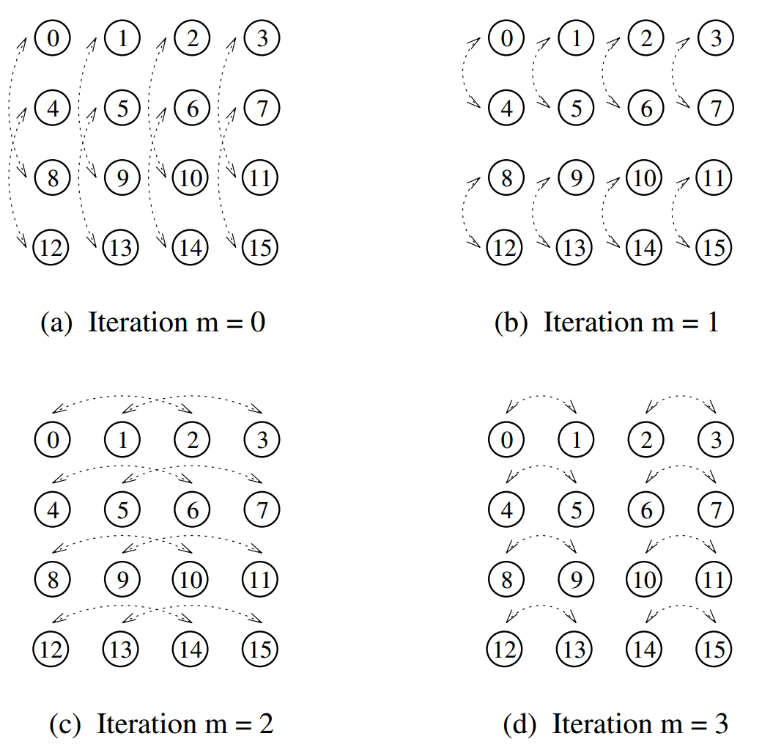
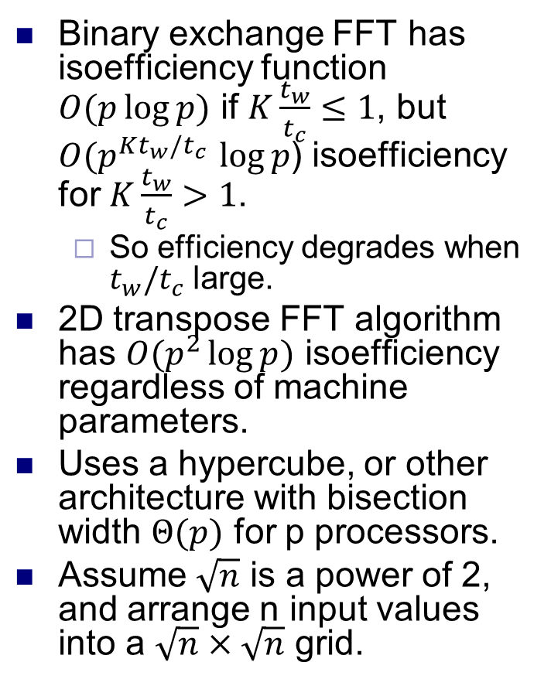
2D transpose FFT
Binary exchange FFT has isoefficiency function $O(p\log{p)}$ if $K\frac{t_{w}}{t_{c}}≤1$, but $O(p^{Kt_{w}/t_{c} }\log{p}$) isoefficiency for $K\frac{t_{w}}{t_{c}}>1$.
So efficiency degrades when $t_{w}/t_{c}$ large.
2D transpose FFT algorithm has $O(p^{2}\log{p)}$ isoefficiency regardless of machine parameters.
Uses a hypercube, or other architecture with bisection width $Θ(p)$ for p processors.
Assume $\sqrt{n}$ is a power of 2, and arrange n input values into a $\sqrt{n}×\sqrt{n}$ grid.

Slide 16
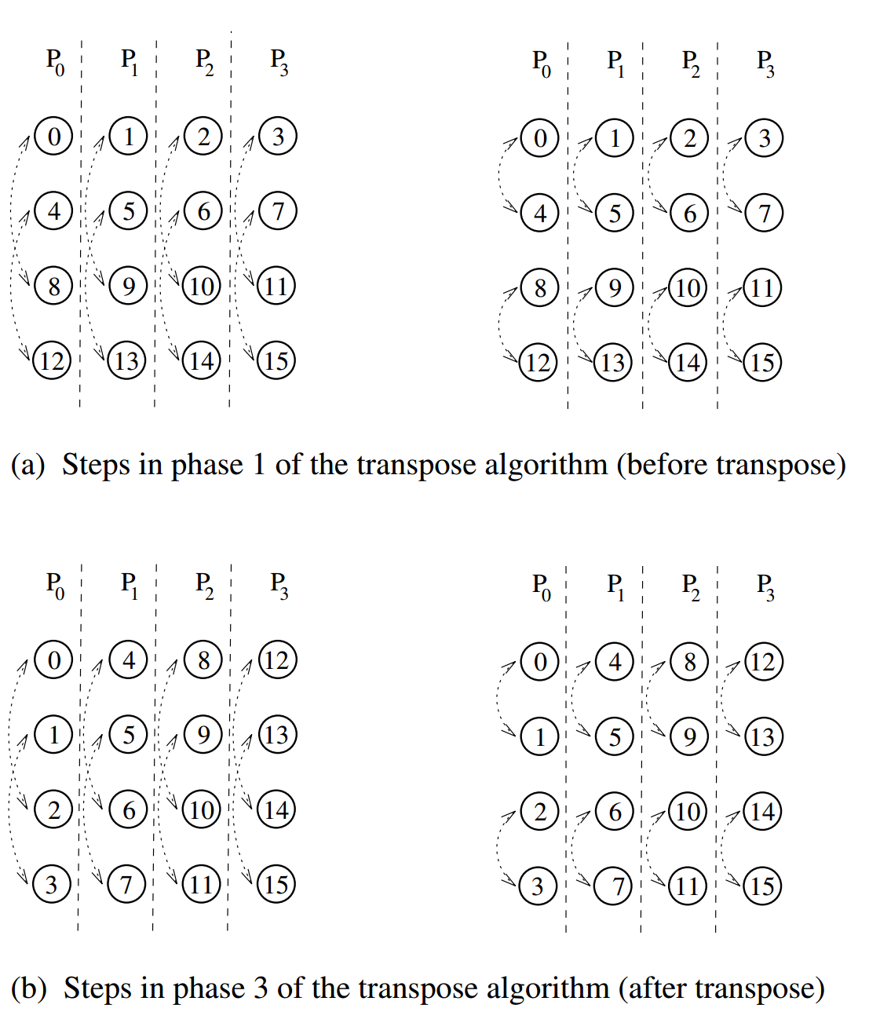
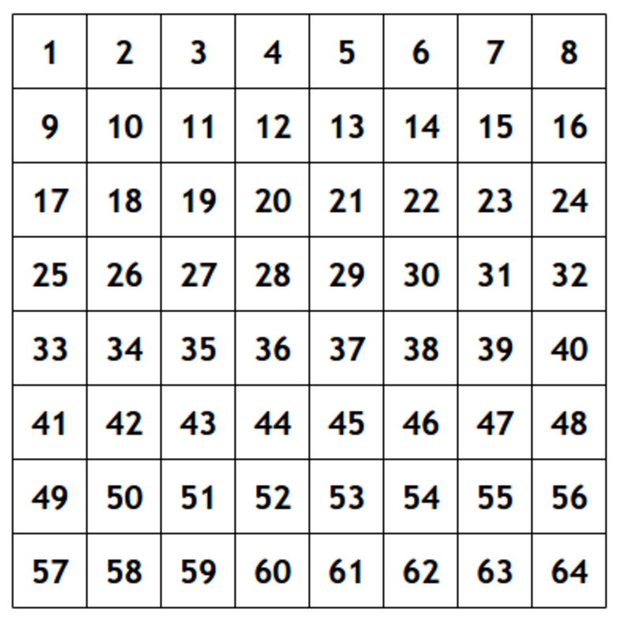
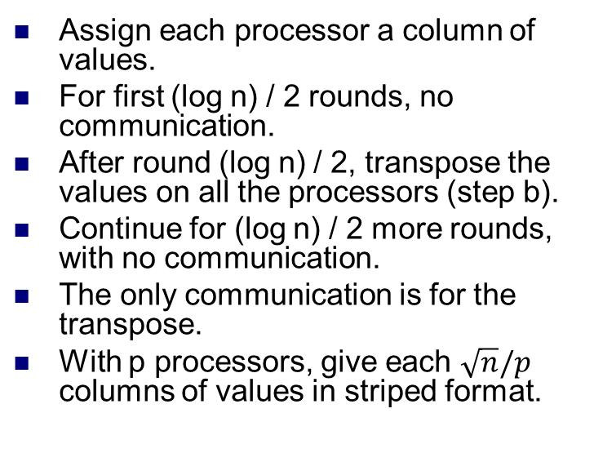
2D transpose FFT
Assign each processor a column of values.
For first (log n) / 2 rounds, no communication.
After round (log n) / 2, transpose the values on all the processors (step b).
Continue for (log n) / 2 more rounds, with no communication.
The only communication is for the transpose.
With p processors, give each $\sqrt{n}/p$ columns of values in striped format.

Slide 17
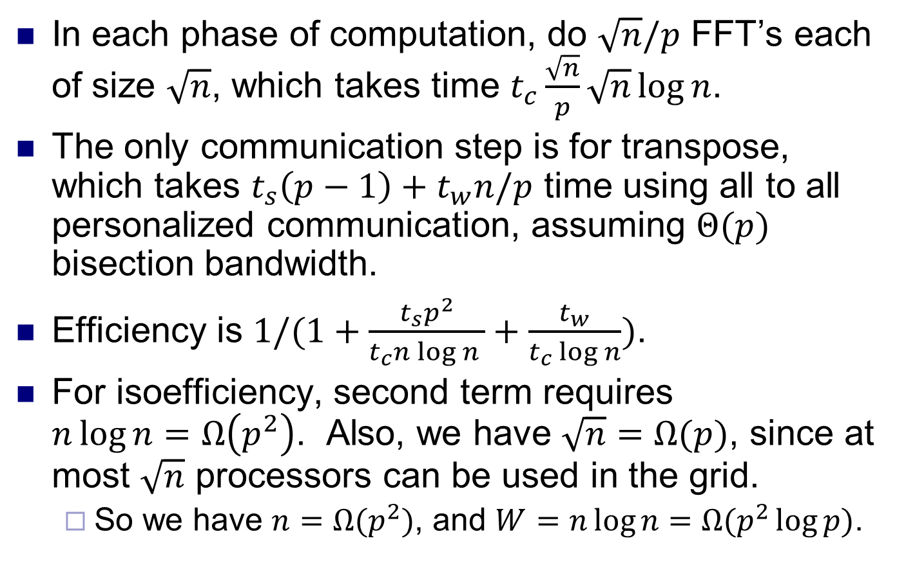
Efficiency
In each phase of computation, do $\sqrt{n}/p$ FFT’s each of size $\sqrt{n}$, which takes time $t_{c}\frac{\sqrt{n}}{p}\sqrt{n}\log{n}$.
The only communication step is for transpose, which takes $t_{s}\left(p−1\right)+t_{w}n/p$ time using all to all personalized communication, assuming $Θ(p)$ bisection bandwidth.
Efficiency is $1/(1+\frac{t_{s}p^{2}}{t_{c}n\log{n }}+\frac{t_{w}}{t_{c}\log{n}})$.
For isoefficiency, second term requires $n\log{n=Ω\left(p^{2}\right)}$. Also, we have $\sqrt{n}=Ω(p)$, since at most $\sqrt{n}$ processors can be used in the grid.
So we have $n=Ω(p^{2})$, and $W=n\log{n=Ω(p^{2}\log{p)}}$.

